Slide 1
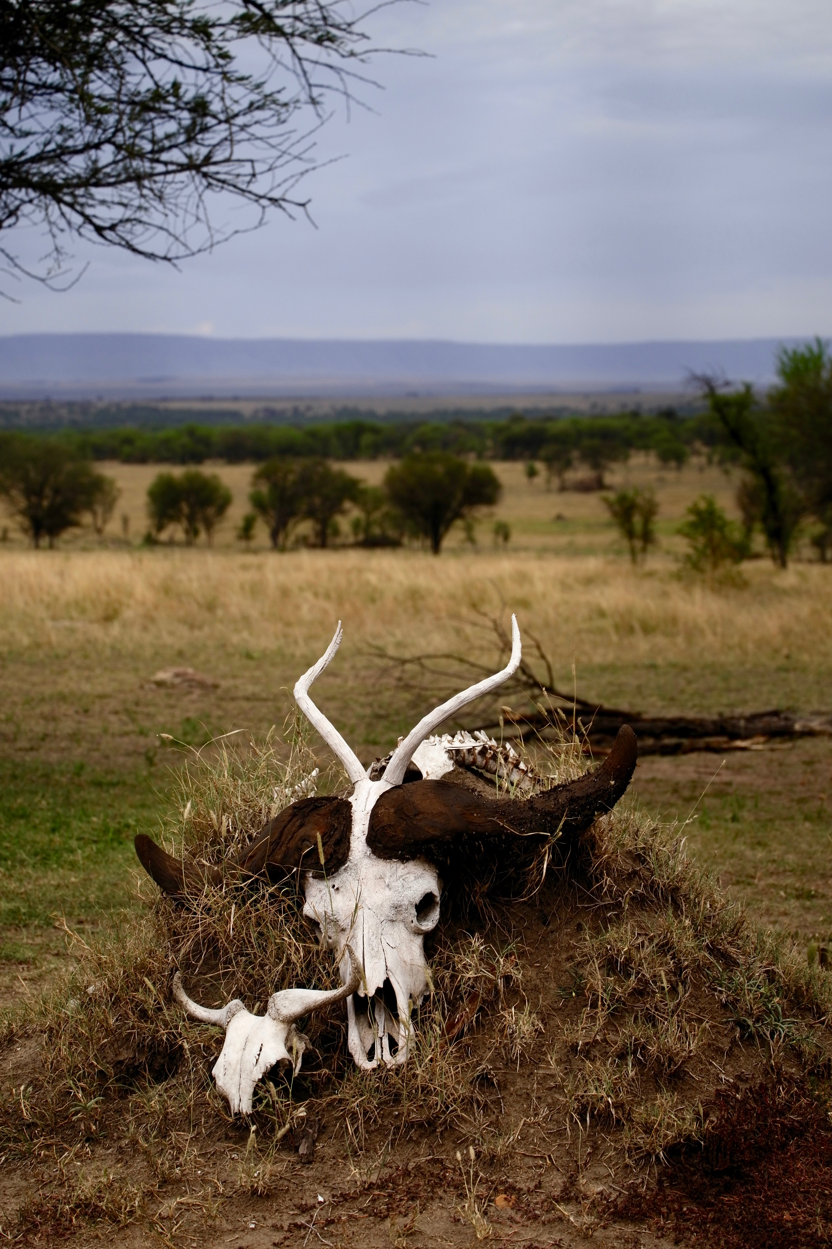
I Report..
By Team <Refactor/>.

Slide 2
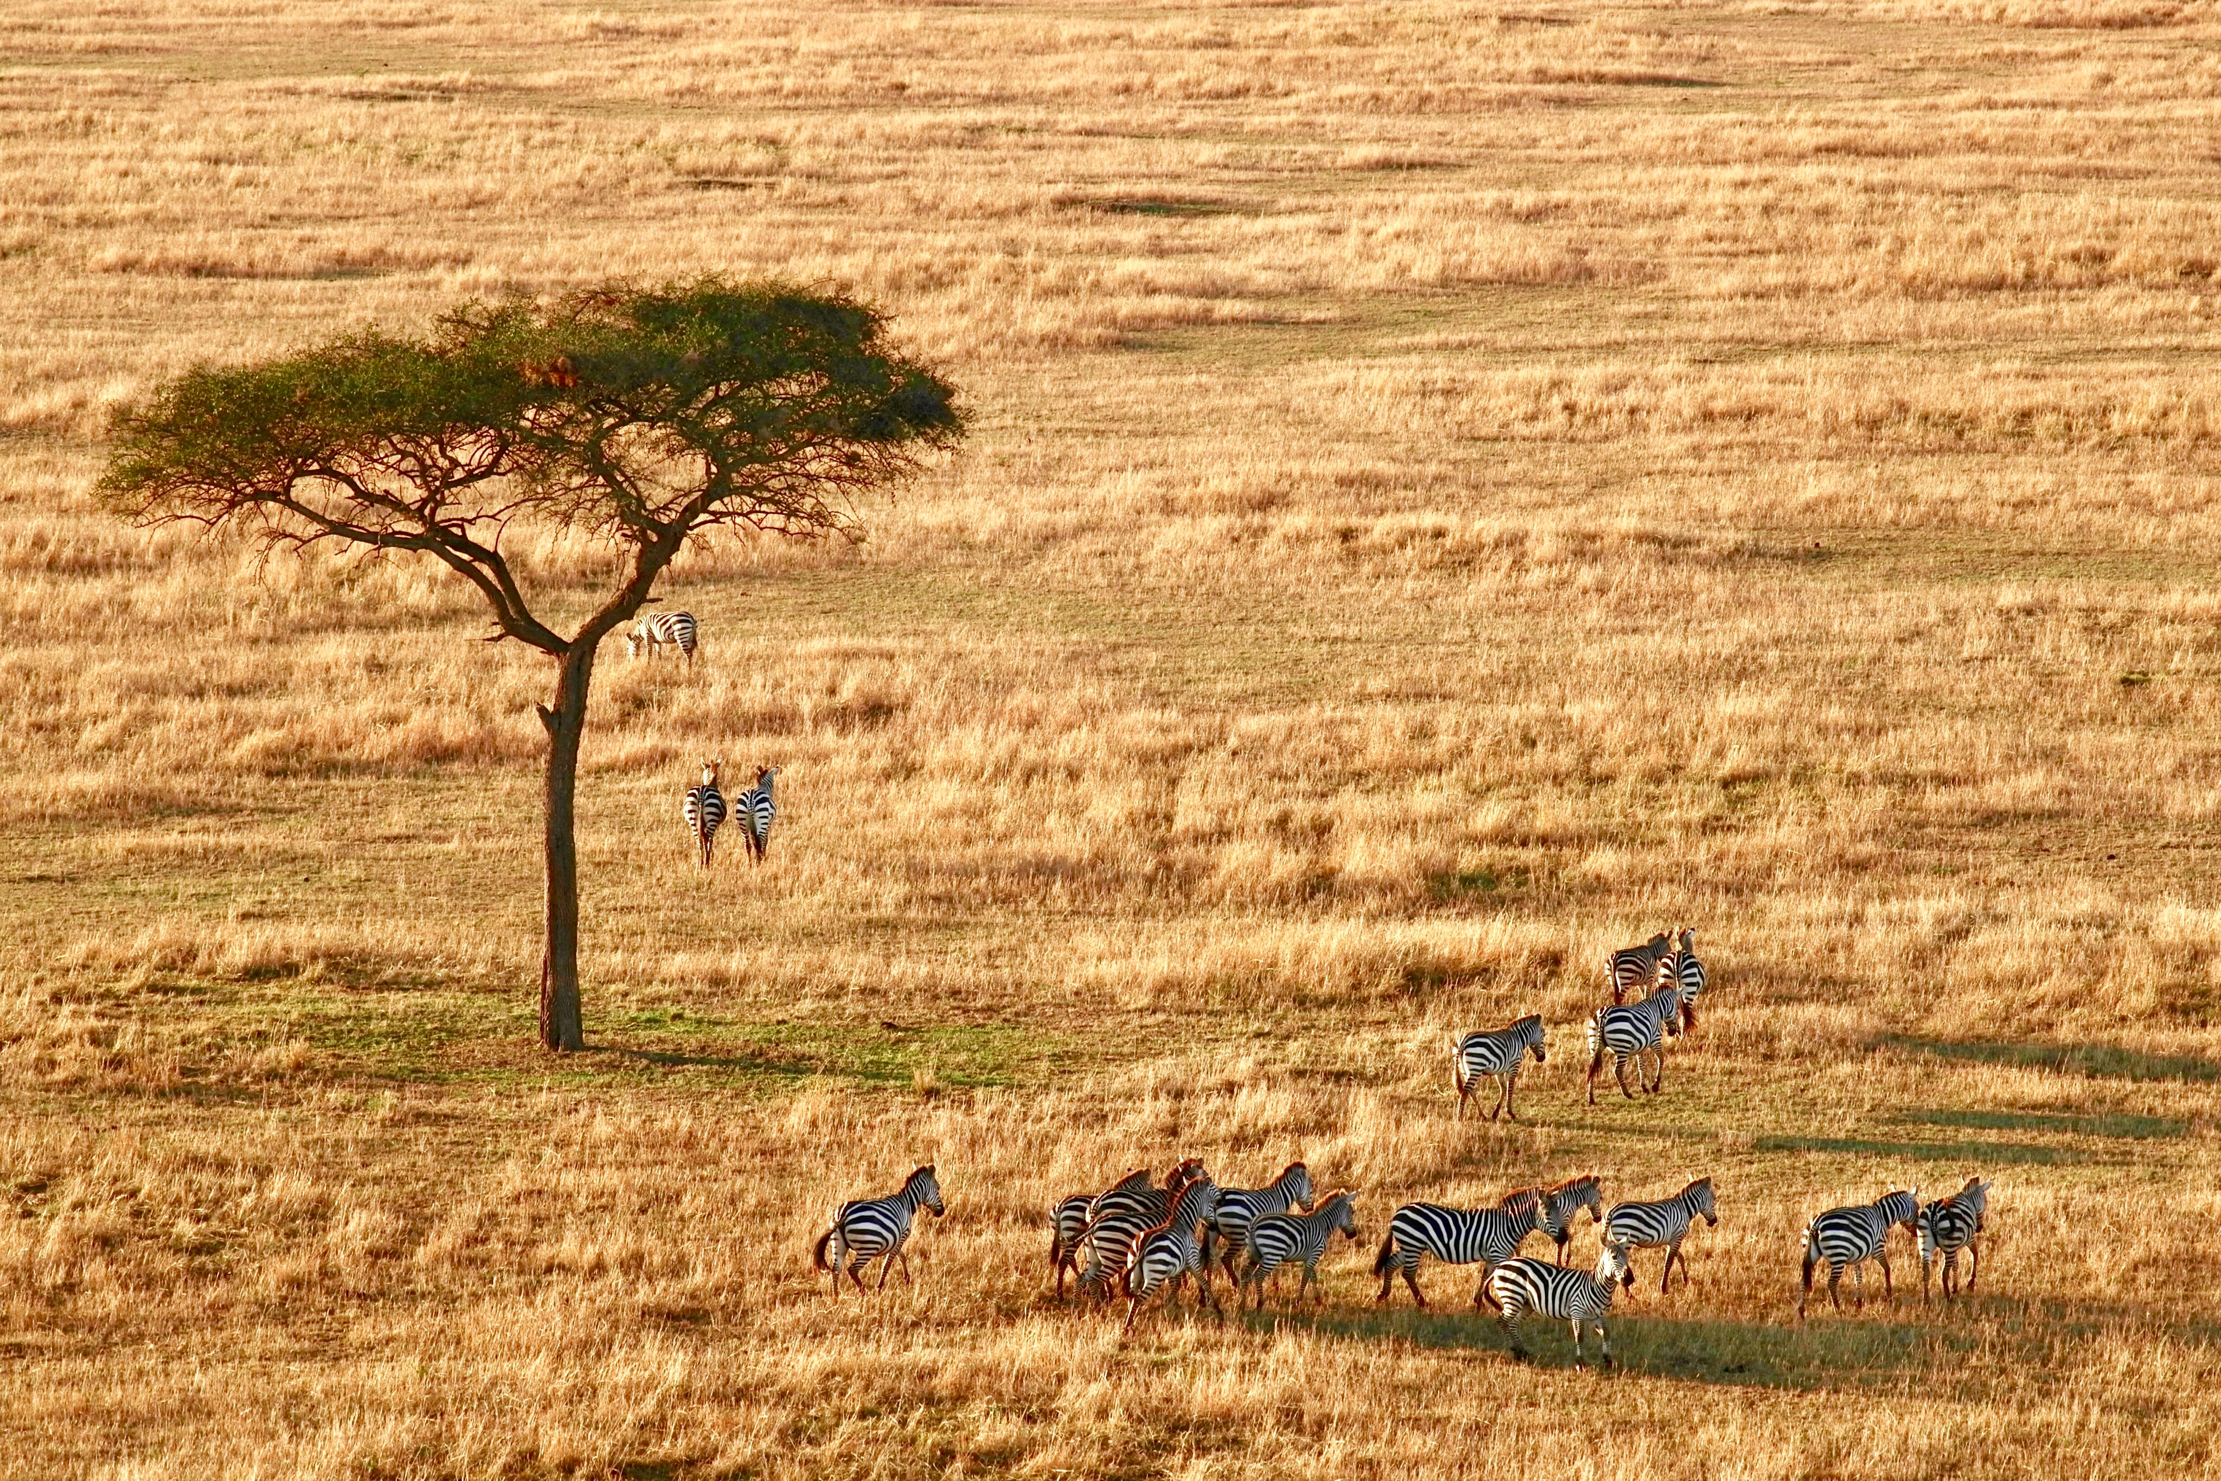
Problem statement 1………….
Establish a path for local communities to report illegal activities to appropriate authorities.

Slide 3
I report introduction
Pic of the app.
I report is a whistleblowing app that allows anyone to report any suspicious wildlife activity.

Slide 4
HOW Does it work?
Local community informants ‘tip-off’ responsible authorities about illegal wildlife activities through the I report app.

Slide 5
What resources are needed?
1.Human Resources => communities, wardens from Uganda Wildlife Authority, technical team, inspectors to inspect if the app is working.
2.Financial Resources.
3.Collaboration with Wildlife Authorities, Tour Operators, police &judiciary.
4. Time .to test, promote and monitor results.

Slide 6
How can it be implemented?
1.Sensitization of the community about the importance of wildlife and it’s benefits.
2.Training the community on how to effectively use I Report.
3.Selecting those who can help to implement the product for example community leaders.
4.If there is a reward, communities will be informed about it.
5.Engaging the community to benefit from wildlife for example local tourism e.g sharing of tourism revenue..

Slide 7
what problem is I report addressing?
Conserving the Environment.
WHAT IS THE IMPACT?
This will lead to increase in tourism, both local and foreign which will lead to increased revenue for the country.
Increased employment e.g. game rangers, researchers, tour operators.

Slide 8
THE Team
Sandra Nanteza
James Besigye

Slide 9
Chandi Mary Gloria
Joshua Ogwang

Slide 10
Thank you for listening.
Any questions?

